Slide 1
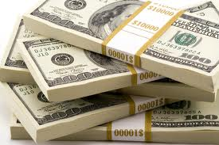
Where Did the Money Go?
Welcome!

Slide 2

Ellen Rohr
100 Jobs, Business Owner
Franchisor
Blogger, Columnist, Author
Biz Make-over Expert
www.ellenrohr.com/cole

Slide 3

The Plumber’s Wife

Slide 4

Here’s the plan
Gain an understanding of basic financial reports
Share a tool for keeping track of the NUMBER$ - The FQC
Explore your level of commitment
Clarify why you are here

Slide 5
FREEDOM

Slide 6
THESE ARE MYTHS!
Do what you love and the MONEY will follow
You must charge the “going rate”
Lower overhead to make money
Profits and principles don’t mix
You gotta work hard…

Slide 7
Let’s get started…
Who’s worked with me?
Financial savvy…1-5
How often do you look?
How much do you want?
Huddle up!
  TOP 3 Financial FRUSTRATIONS!

Slide 8

The Balance Sheet
ASSETS = LIABILITIES + EQUITIES

Slide 9
The Profit & Loss
Aka The Income Statement
$ Sales 100%
- $ Costs 75%
_____________________
$ Profit 25%
Notes:
L: DEMO the transactions

Slide 10
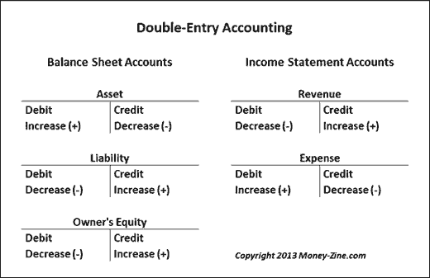
DEMO – Double Entry Accounting http://www.youtube.com/watch?v=2-HK4qSz6cA
Thanks to Joe! AND, Luca Pacioli?

Slide 11

www.ellenrohr.com/cole

Slide 12

Are you operating from a K.F.P.?

Slide 13

K.F.P.
Known – current, accurate,
understood
Financial
Position

Slide 14

Bean Team Meeting

Slide 15
Review your Financials
Are they a big, slinky knot mess?
“-” where they shouldn’t be
a MIX of CAps and Missspellins
“Other” and “Misc”
Too looooooong
Weird words – “Alternative Owner’s Draw”
Best advice… Here’s mine…
  Line by line! ☹ ☺ ??

Slide 16
Chart of Accounts
SIMPLE…use it to make a decision?
Big Rocks…Sales, Labor and Materials
Allocating Overhead?
Job Costing…Big Rocks
Make notes on YOUR financials!
Best advice… WHAT IS THIS?

Slide 17
Operating from a KFP…
Sleep better
Argue less
Measure progress
Assess decisions
Hold yourself and team accountable
Make better, faster, more $$ decisions

Slide 18

What if the numbers STINK?

Slide 19
The “B” Word
Your Budget delivers…
GOALS
  Sales
  Expenses
  %s, $s
SELLING PRICE
  Justification for HOW MUCH

Slide 20
The Baby Budget
The Desensitization Run
Big Rocks…Per Division
Key Numbers
Selling Price
Goals… $, #, %
www.ellenrohr.com/cole

Slide 21







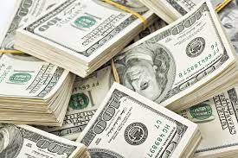
How Much Do You Want?

Slide 22

Pick a Buddy!

Slide 23
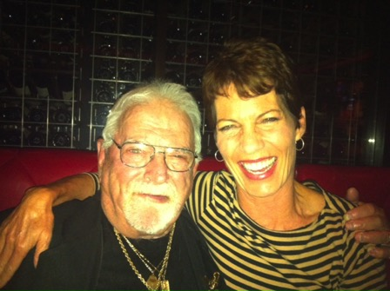
Selling Price Formula…
the Frank Blau Method
CONFRONT the numbers!
Divide costs by Widgets, Billable Hours.
Charge more than it costs!
IGNORE what others do

Slide 24
The Watermelon Principle

Slide 25
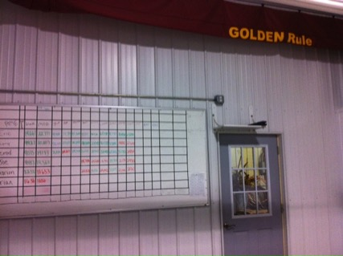
Keeping Track of the NUMBER$
      The Balance Sheet
      The Income Statement
      FQC - Compare to Budget…weekly
      Service Tech Scorecards
      Scorecards for every Position?

Slide 26
The Financial Quick Check
Notes:
SHOW ON LAP TOP

Slide 27
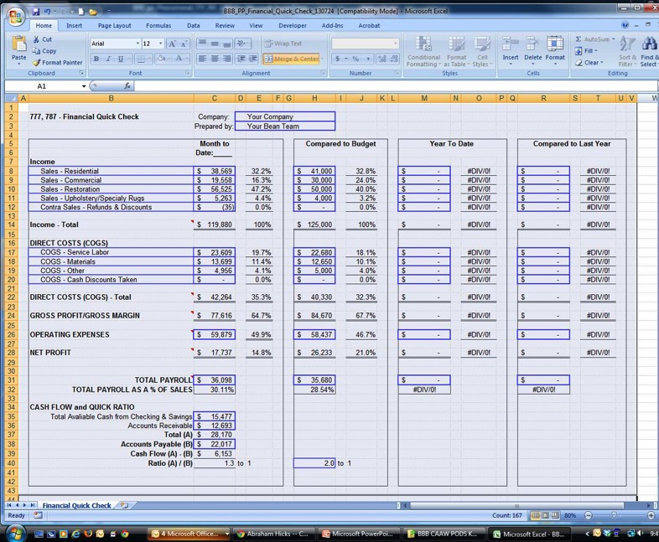
The Financial Quick Check

Slide 28

The Financial Quick Check
“Ellen changed my company forever!
The most immediate change made was,
as we started to get into the company’s books,
I realized that what my bookkeeper was saying he was doing,
he was not doing. He was being coy about my direct questions…so he is gone.
“Now there are no secrets! Every week, we go through the FQC. The numbers are real, we have a plan in place, and we know what questions to ask and where to get them answered if something looks off. ~Jim Papalia
Notes:
SHOW ON LAP TOP

Slide 29
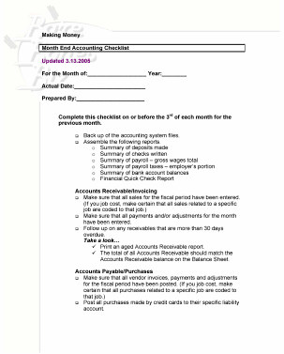
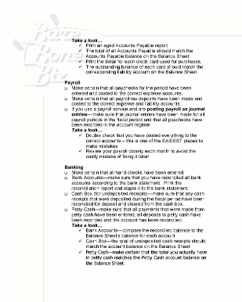
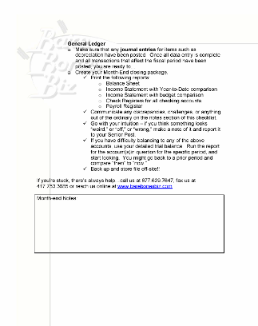
The Month End Checklist

Slide 30
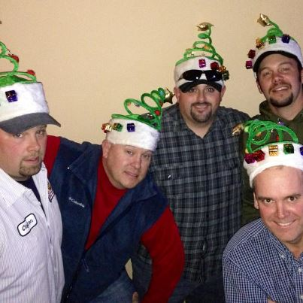
Get Your Team in on the Game?

Slide 31
How to MAKE MONEY EVERY MONTH
PAY ATTENTION
  People, $$, systems
Raise your prices
  PROVE it…Budget!
Sell yourself
Sell your TEAM
Find the RIGHT Customers
BE extraordinary!
Notes:
.

Slide 32


Write Down 5 Things…
Skip to content
Home
BUY STUFF
About Us
Podcast Series
1 _______________
2 _______________
3 _______________
4 _______________
5 _______________
5

Slide 33
www.ellenrohr.com/cole

Slide 34


www.ellenrohr.com/cole

Slide 35

Thank You!
Notes:
Closing thought: Make the commitment. Plan your business and discover the freedom that an honorable, profitable, true-to-you business can bring. Click on the Chat link to get to the site.

Slide 36
How Much Should I Charge?
Welcome!

Slide 37
I’ll share a philosophy…
Business is EASY
Let’s help each other
Gain CLARITY!
Develop courage….
  You’ve got to charge MORE
  ____ __ _____!

Slide 38

The Plumber’s Wife

Slide 39
Do what you love?

Slide 40
Here’s the plan
Remember why you are here ☺
Explore The B Word
Revisit the FQC for keeping track of the NUMBER$
Share a simple, powerful pricing formula
Discuss Flat Rate Pricing, Service Agreements…and other pricing options
“Sweet Spot” jobs
Discover who your customers are…and aren’t
Explore how to charge more and get, “YES!”

Slide 41
FREEDOM

Slide 42
Keeping Track of the NUMBER$
      The Balance Sheet
      The Income Statement
      FQC - Compare to Budget…weekly
      Service Tech Scorecards
      Scorecards for every Position?

Slide 43
The Balance Sheet
ASSETS = LIABILITIES + EQUITIES

Slide 44
The Profit & Loss
Aka The Income Statement
$ Sales 100%
- $ Costs 75%
_____________________
$ Profit 25%
Notes:
DEMO the transactions

Slide 45
Only three ways to grow
Assets…
Borrow
Put money in
Charge more than it costs
Umm, maybe four ways…

Slide 46
WORST way to set prices…
???
$$$

Slide 47
Selling Price Formula…
the Frank Blau Method
CONFRONT the numbers!
Divide costs by Widgets, Billable Hours.
Charge more than it costs!
IGNORE what others do

Slide 48
Selling price formula for your TIME…
Want to make $100K?
1000 hours per year?
$100 per hour!
Add costs of doing business
YIKES!

Slide 49
How much to charge?
It’s a self esteem problem…

Slide 50
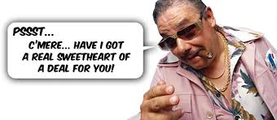
The SALES and Service TEAM!
Until a sales is made,
nobody is working…

Slide 51
Your Sales GOAL comes from
YOUR BUDGET!
Start with EXPENSES…then finish the Top Line!

Slide 52
How to Triple your Prices and Double your Customers…
PROVE it…to youself and your team
When P < V…SALES at any Price!
The Starbucks Factor
What makes you BETTER?
Let’s List the Ways!

Slide 53

Flat Rate vs. T&M?

Slide 54

The Difference Between
High Priced Contractors
and Low Priced Contractors…

Slide 55
Until the VALUE is established… the PRICE is too HIGH!
It’s too high for you, your team,
and too high for your customers!

Slide 56
What does your customer want?
Save Money?
Save the Earth? Feel Better?
Reduce Oil Addiction?
Be Comfortable?
Easy to Operate System?
Find “My Guy!”

Slide 57

Finding the “Sweet Spot”…
Modest Labor
NICE Materials
  Remodel?
  Replacement?
  Add Ons?
The magic is YOU…

Slide 58
Leveraging Time and Products
The Tipping Point
The kind of jobs you WANT?
Selling Price Worksheet

Slide 59
The Selling Price Worksheet
Job Name | Mrs. Ferwicky
Date | Today
Material |  | Labor | Estimated Hours
Nice Materials | $ 10,000.00 | Warranty | 0
 |  | Lead Installer | 5.00
 |  | Junior Tech | 5.00
 |  | Apprentice
 |  | TOTAL | 10
 |  | PERMIT
 |  | SUB CONTRACT
TOTAL | $10,000.00 | TOTAL | $0.00
 | OVERHEAD / LABOR HR METHOD |  | GROSS MARGIN METHOD
Labor | $3,000.00 |  | $500.00
Material | $12,500.00 |  | $13,333.33
Subcontractor | $0.00 |  | $0.00
Permit | $0.00 |  | $0.00
Lead Installer Bonus | $0.00 |  | $0.00
Junior Tech Bonus | $0.00 |  | $0.00
Total | $15,500.00 |  | $13,833.33
FR - Overhead/Labor Hour Price | $300 |  | Desired Profit % | 20%
Gross Margin Labor Price | $50 |  | Desired Gross Profit % | 25%
Salesperson Commision |  | $0.00 |  | $0.00
JOB SELL PRICE |  | $15,500.00 |  | $13,833.33
Tax on materials % | 0.000% |  | Salesperson Comm % | 0%
 |  |  | Lead Installer Daily Bonus | $0
 |  |  | Jr Installer Daily Bonus | $0

Slide 60
The Problem with Gross Margin…
Job One (no materials, lots of labor):
  Sales $5,000
  COGS/Direct Costs 2500
  Gross Profit $2,500 50% Gross Margin
  Gross Profit per Hour $25
Assuming we pay $25 per hour for Labor for 100 hrs
Competitor gets this job

Slide 61
The Problem with Gross Margin…
Job Two (nice materials, low labor):
  Sales $29,800
  COGS/Direct Costs 20,400
  Gross Profit $ 9,400 31.5% Gross Margin
  Gross Profit per Hour $587.50
Assuming we pay $25 per hour for Labor for 16 hrs and $20K in materials
We get this job…The Sweet Spot!

Slide 62
Until the VALUE is established… the PRICE is too HIGH!
It’s too high for you, your team,
and too high for your customers!

Slide 63
Sell YOUR TEAM
WIIFT? Bonus! How do they WIN?
Are they held accountable?
If you track, you must teach!
Adopt a Sales Guru

Slide 64
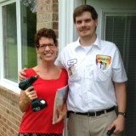
Ask good questions and LISTEN…
Come up with 5…
Apples to Oranges!
Less is MORE

Slide 65
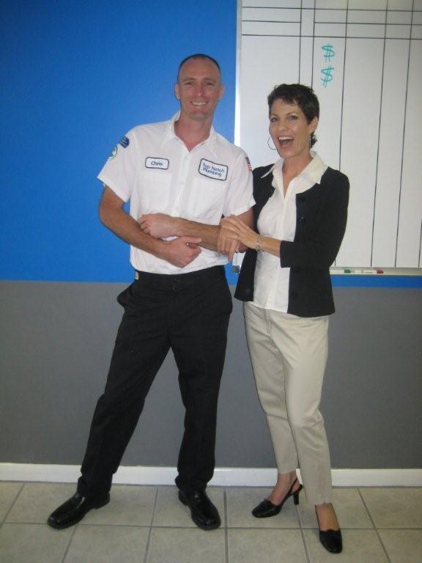
Coaching Session!

Slide 66

What’s NOT in the Manuals…

Slide 67

Will They Take a Bullet for You?

Slide 68
You can HAVE it all…if you don’t DO it all!
Get your Team in on it.
Keep Score to Make More.
Delegate…don’t Abdicate.
Communicate.
Take the Bullet…

Slide 69
What do you want?

Slide 70
www.ellenrohr.com/cole

Slide 71
www.ellenrohr.com/cole

Slide 72
Thank You!
Notes:
Closing thought: Make the commitment. Plan your business and discover the freedom that an honorable, profitable, true-to-you business can bring. Click on the Chat link to get to the site.

Slide 73
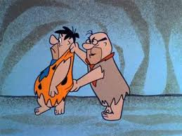
Reward the Right Stuff and get your team in on the game!
Welcome Back!

Slide 74

Let’s find out…
Survey…HMOY
  Fence testers?
  Hostage situation?
  Kooky family?
  Team struggling w prices?
  Help them win, grow
You, your team want…

Slide 75
Here’s the plan
Build on financial understanding
Your Mission – Why? – and your Plan
RTRS – discuss what a good compensation and bonus program involves
Salary Levels…what it takes to get a raise
Scorecards…what it takes to get a bonus
The Door…what it takes to get fired
The Point…what it takes to get good
How to change the way you pay without trauma
The Case for Open Book Management

Slide 76

Where you’ve been, are now, are going?

Slide 77
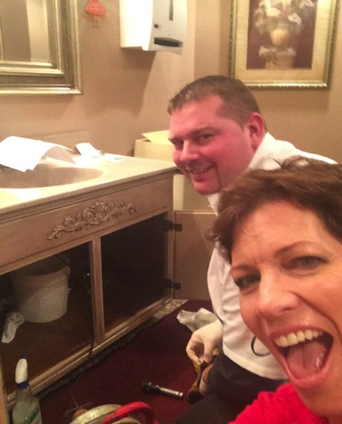
Get Your Team in on the Game?

Slide 78

Goals
  To HAVE Statements
    $$s
    #s
    %s
    Things
Notes:
KEY to a profitable business plan…Make money NOW and as you GROW. Warren Buffet rules. Jack Welsch quote about losses in the short run.
In this section…
Bean Team
Getting to KFP – Current, accurate…good Chart of Accounts. Simple…EASY.
Budgeting – Goals and Selling Prices.
FQC.
Month End Checklist

Slide 79

How Much is Enough?
What is in it for them?
Money?
Recognition?
Safety, Security?
Love? Peace?
Being in on something GREAT?

Slide 80

KIDS TODAY...

Slide 81
Sir Walter Bilbey said…
“The employer
generally gets
the employee
he deserves.”

Slide 82
75%

Slide 83

Create a Good Game
A game consists of…
  RULES
  REWARD
    Main Course
    Dessert
  RIGHTS
  REASON

Slide 84
The Org Chart

Slide 85
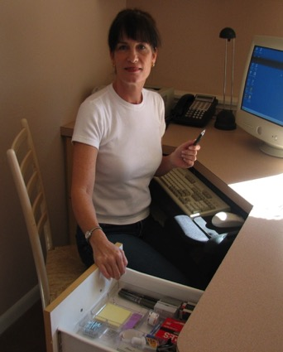
Position Descriptions
For example…

Slide 86

Salary Levels
Written, fair, clear.
For example…

Slide 87
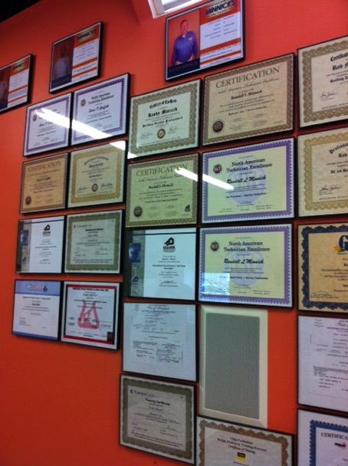

Slide 88
The Manuals
Simple Position Descriptions
  WHAT to do…
  Clean, sober, on-time, dressed right and _____
Simple Procedures – The Manuals
  HOW to do it…what few things must be done every time?

Slide 89

SKIP the Attitude Discussion!
The real problem with your employees…is YOU!

Slide 90
“What does it take to get fired around here?” Role Play

Slide 91
How to Get Fired! ☺
    Rubber Bullet
    Written Warning
    Suspension
    Out of here
    If you want to save her…
      show her where the door is!

Slide 92
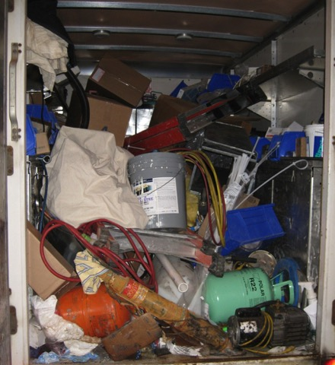
Will you hold them accountable…
for OPERATIONS?

Slide 93
Will you hold them accountable…
for SALES?

Slide 94
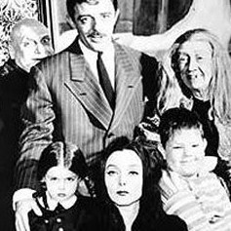
Will you hold yourself accountable?

Slide 95

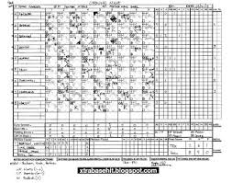

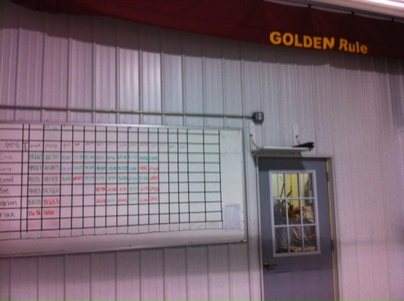
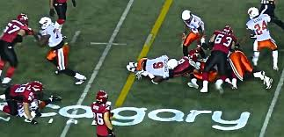
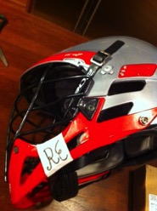
Keep Score

Slide 96
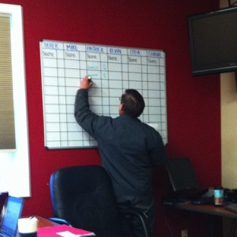
Adopt a Sales Guru
Are you willing to charge what you need to charge?
Can you add enough value to get to “Yes!”?
Are you willing to learn how?
Notes:
In this section…
Sales phobia
Marketing Plan – Budget, Allocation, Calendar
IF YOU HAVE A marketing plan…incorporate yours!
Sales and Service celebration culture!
How Tos…Sales Meeting, Scorecards, Ride Alongs.
In the Binder…The Marketing Plan and the Sales Scorecards

Slide 97
Your Sales GOAL comes from
YOUR BUDGET!
Start with EXPENSES…then finish the Top Line!

Slide 98
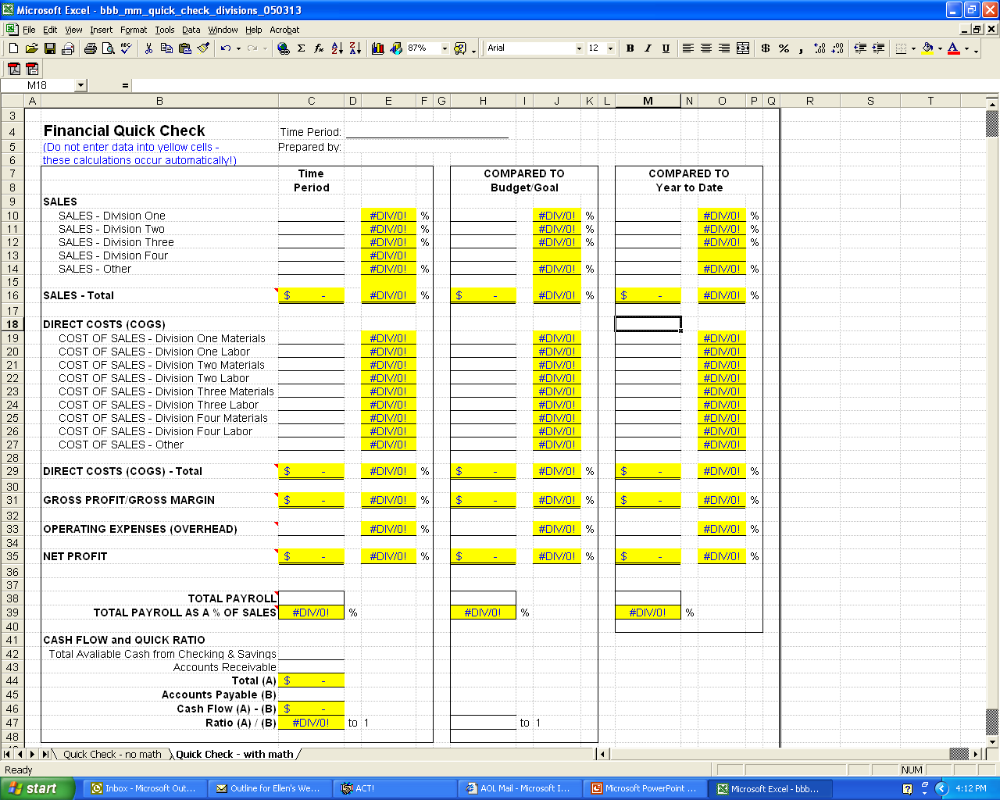
The Financial Plan
Notes:
KEY to a profitable business plan…Make money NOW and as you GROW. Warren Buffet rules. Jack Welsch quote about losses in the short run.
In this section…
Bean Team
Getting to KFP – Current, accurate…good Chart of Accounts. Simple…EASY.
Budgeting – Goals and Selling Prices.
FQC.
Month End Checklist

Slide 99
$1,200,000 for total Sales Goal
So…what’s the Goal for each Service Tech?
Sam ?? | Sue ??
Sally ?? | Steve ??

Slide 100
The Fair Share Approach
Sam $300K | Sue $300K
Sally $300K | Steve $300K

Slide 101

Bonus Opportunities for Each Division, Position
Bonus Basics…Beat the Budget!
Exceed Sales Goals
Deliver Less than Expected Expenses

Slide 102
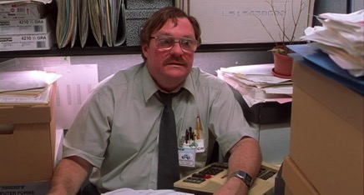
Bonus Basics…
Bonus Basics
New approach? Keep score for ONE Quarter before you kick in the bonus.
BE CAUTIOUS about PAY!
  Deliver to Goal, keep this great job.
  Exceed Goal, you get a BONUS % of Sales above Goal.
Scoring is WEEKLY and PUBLIC.
…Horror stories??

Slide 103
Bonus Basics continued…
House wins first.
Help your team WIN.
Bonus is subject to qualifiers…
  Close Rate
  “Sign Off”
  No Write Ups

Slide 104
Straight Commission vs. Salary PLUS Commission
Straight Commission…
  Rewards the “Sales Machines”
  Watch for “lazy” management
  What happens on Thursday?
Salary PLUS Commission…
  Salary has to be “uncomfortable”
The Pros and Cons of Hourly wage…
Bonus…a WIN above GOAL!
NOW…what do YOU think…

Slide 105
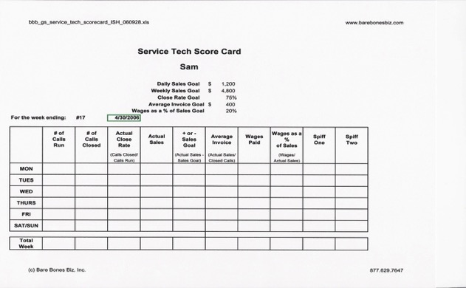
The Service Tech’s
Scorecard
Notes:
It is week two in the third month….

Slide 106
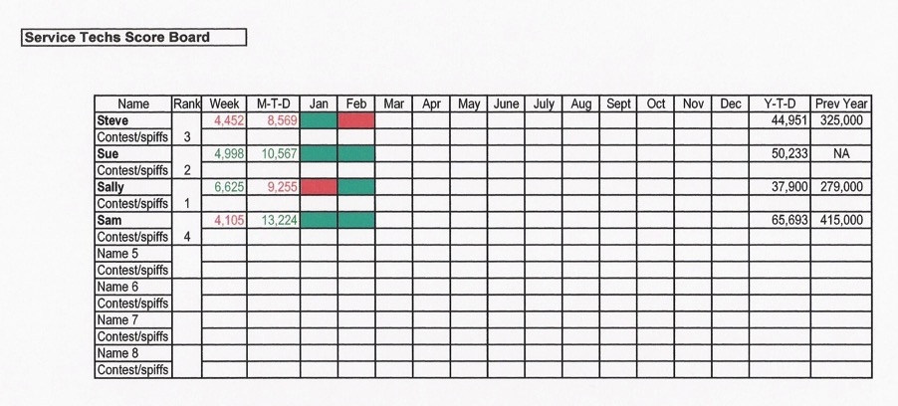
The Service Tech’s
Scoreboard

Slide 107
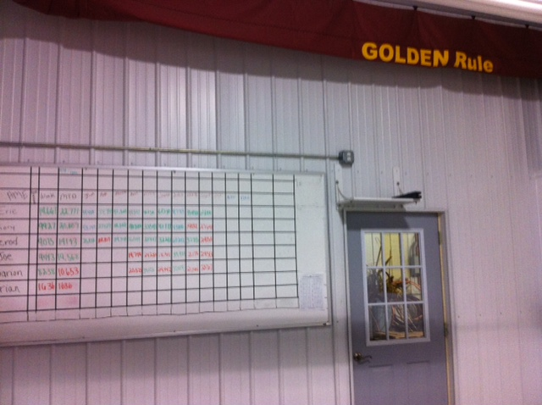

Slide 108
The GAME
for Service Techs
      The House Wins FIRST…
        Bonus is for OVER Goal.
        Remember…Budget is Goal
      The Qualifiers…
        Close Rate
        NO Write Ups!
      Fair Share of Goal.
      Close is not enough.
      Bonus delivery day…Win Win Win

Slide 109
The GAME
for Service Techs (cont.)
      Qualified Sales above Goal…
        Great wage/salary is for up to Goal.
        10-15% of Sales above Goal.
      The Sales Manager Cut…
        5-10% of Sales above Goal
        Qualifiers for the SM
        Gross Margin at or above Goal.
        Position Description responsibilities done.
        Remember…Budget is Goal…
        watch total Payroll as a % of Sales!

Slide 110

It’s OK if it’s Tough

Slide 111
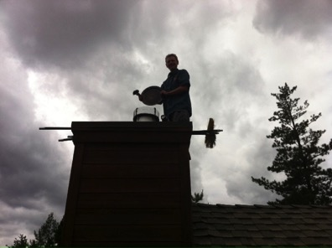
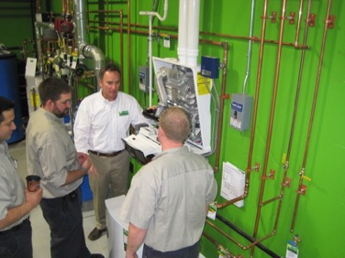

Training and The Ride Along

Slide 112

What’s NOT in the Manuals…

Slide 113

You don’t need to have it all figured out.

Slide 114

The Mary Kay Effect
“My attention on that person.”

Slide 115
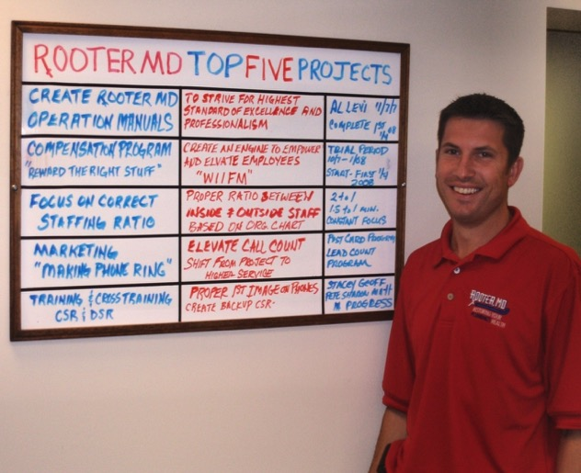
Top Projects List

Slide 116

Delegate…Don’t Abdicate.

Slide 117
The Steps of Delegation…
What.
Why.
Who.
How Much.
By When.
What’s the GAME?

Slide 118
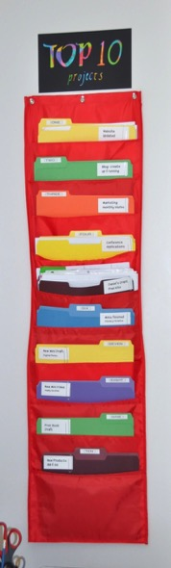
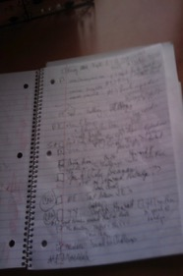
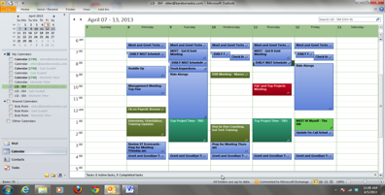
The Meeting with YOU
Intention to Action…
  Your Biz Plan
  The Top Projects List
  The Master to do List
  Your Calendar
Notes:
Deep Dish
SHOW the Calendar…DEMO the Meeting with YOU!
MAKING GOOD ON YOUR PROMISES!

Slide 119
www.ellenrohr.com/cole

Slide 120
www.ellenrohr.com/cole

Slide 121
www.ellenrohr.com/cole

Slide 122
Thank You!
Notes:
Closing thought: Make the commitment. Plan your business and discover the freedom that an honorable, profitable, true-to-you business can bring. Click on the Chat link to get to the site.

Slide 123

Buying, Selling and
Getting OUT
Acquisition and Consolidation Strategies
Welcome!

Slide 124

What’s Your Number?

Slide 125
Here’s the plan
Parlay your financial savvy into wealth
Easier-than-you-may-think basics for busying and selling companies
How to find, approach, present and CLOSE deals
What about employees?
When, why and how much to get OUT
What’s in store for the industry?
What do you really, really, really want? And how to get it!

Slide 126








Webinar/Seminar Land
Notes:
You are in the right place if…
Information…not really the problem. HMOY struggle with implementation v. information?
HMOY look up and find that it is 5 pm and you haven’t had lunch?
I am NOT a naturally organized or efficient person. Ask a few of my former bosses!! Focused is not a word they would have used. But I like to WIN. How about you?
Learned a lot from Jim Rohn, Frank Blau… Bit of a mess organizationally, but starting to put some personal organizational systems together. Stephen Covey.

Slide 127

The Power of Intention
Notes:
Jim Abrams sealed the deal for me with Planning. Asked me to lead the charge. $40 mil, 47 locations, and they continue to grow. Didn’t know what I was doing. Franchising for Dummies. Then, he asked me to put a plan together. Gave me a template.

Slide 128


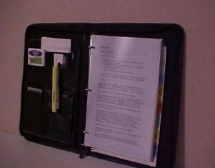
The Bare Bones Biz Plan
Notes:
I’ve refined the process. This is how I do it…with my business, my clients. This is what you will learn today.
A business plan makes your business REAL. Story about M3 participants.
More than a typical biz plan…engages LIFE and business. Not just about financial freedom. It’s about making a difference. Having a life…and a lifestyle. Inspriation and implementation.
You have to sell this idea…to yourself, your partner, your family, your team, the banker, the investor. “It may not look like much…let me show you the plan!” Today…I’ll show you how I created my plan. You can create your OWN plan, too. A relevant plan. One that drives YOU.
What’s cool is that you…Get focused Get going Get profitable
I’ll teach you as much as I can in this hour. At the end of the hour, I promise I’ll show you how to take this information further, and share some details about the Biz Plan Challenge. Type your Questions in…I will address at the end. Or, clarify as we go along! I’ll honor your time and wrap at the end of the hour. I can stay on the line for a few minutes after to say howdy, too!

Slide 129

The Bare Bones Biz Plan
Setting Sight
Building the Team
Making Money
Getting it Sold
Getting it Done
Making Sure
Notes:
How would you do it? Start with a plan. My latest book is The Bare Bones Biz Plan. In this book, I wrote down the few things that, if done on a consistent basis, would make all the difference to your business success. I am proud of this book. It is a sound, simple approach to putting a winning business plan together and for holding yourself accountable for getting it done.
Now, if you have a plan already, use it. Dust off the one you showed to the bank 100 years ago and start with that. If you don’t have a plan, try this:
Get a three ring binder. You can get a nice leather one at Office Depot for about 30 bucks. Or, use one of your kids’ sixth grade leftovers. Make sure it is in nice, clean condition. Your best work is going in it. This Binder is going to house your Business Plan. Call it your Biz Plan Binder.
Get at set of tabs that fit into your Biz Plan Binder. Get the customizable, write-on kind with 8 tabs in the set. Tab up your Binder like this…
Setting Sight – What does it look like when you're done? How much in Sales? How many employees? Number of customers served? What services will you offer? What will you do different and better from the competition? This tab of your Biz Plan Binder houses the pages that describe your ideal business, your target market, your goals and how this business serves you, your family, your team and your customers.
Building the Team – Who does what? Why, how and when? Use this section of your Biz Plan Binder to store your Organizational Chart and Position Descriptions. Keep your recruiting activities organized here.
Making Money – Keep a current copy of your financials in this section. Are your books a mess? Craft an action plan for getting to KFP – a KNOWN Financial Position. Build a Budget and set Goals, in $$s and %s for Sales and Expenses at your new and improved company. Get REAL about your selling price. Crunch the numbers…and commit to implementing higher prices. Which leads us to…
.
Getting it Sold – If you are going to charge more (and, face it, cutting costs won’t make up for years of financial losses) you are going to have to BE more…be faster, nicer, cleaner, more organized, professional, timely and loving. And, you will need to discover better ways to communicate the value of your service to customers and prospective customers. Craft an action plan for improving your sales skills. Store your marketing plan under this tab in your Biz Plan Binder.
Getting it Done – As you develop your procedures, sure-fire systems for delivering on your promises, store copies of your procedures under this tab. Create a Top Projects list and assign projects to Team members. Be sure to include the due dates. Note the employees who rise to the 7 day Extreme Makeover Challenge. These are folks you want on your team.
Making Sure – Are you on the right track? Are you delivering what people want? Is this working? Ride along with your field team. Sit side by side with your inside team. Ask your customers to give you feedback…what’s working, what needs to be madeover? Organize your Making Sure activities in this tab of your Biz Plan Binder.
(Sure, you could keep all this information on your computer. Do it! However, a nice, printed, portable Biz Plan Binder is helpful for showing others where you are going and how you are going to get there.
Also, feel free to “plus” my suggestions. These tabs are one way to organize your plan. Got another approach? Terrific. Use it!)
The two additional tabs can be used for the Master To Do List and your Journal.
The Master To Do List – You are going to have lots of great ideas for your business. However, you can’t do everything all at once. You will learn to prioritize your ideas and focus your energy on the things that will have the most impact on your business success. When you, or a team member, have a good idea, or think of something that needs to be done, a “to do”…jot it down on the Master To Do List.
The Journal – This is where you write down the story of your business. You can use a Word document, and type out your thoughts. Or, insert a few blank pages and store them in the Journal section of your Biz Plan Binder. Date your entries. You will learn wonderful lessons as you create and implement your business plan. Keeping a Journal will help you to remember those lessons, and give you a nice way to pass the lessons along.

Slide 130

What do you WANT?
Your Perfect Day

Slide 131
Buying and Selling Companies
Which side of the table?
Traditional and “Street Smart” approaches.
No need to be intimidated.
Commit to win-win-win!

Slide 132

How to use a lawyer…
One woman’s opinion…
Get CLEAR on what you want.
What are the risks?
How to structure the agreement?

Slide 133
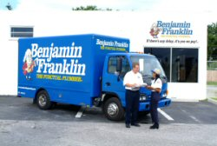
Traditional Valuation
Earnings Approach
Asset Approach
Market Approach
Due Diligence
  Do YOU believe?
Notes:
Overview of the buying process….
The basic game plan for buying a service company goes like this:
Are you ready to buy a company? You define goals for yourself and your company.
Is your company ready to buy a company? You create an action plan for strengthening your company.
You determine if you and your company are willing, able and ready to buy a company based on Due Diligence of your own company.
You create a template for the kind of company that you are looking for.
You assemble a ‘Dream Team’ of professional advisors.
You recruit/attract possible candidates for purchase.
Letter of Approach.
You set your sights on a company and make your intentions known.
Confidentiality Agreement.
Request Business Information.
You analyze the financial and organization aspects of the company.
You analyze the cultural issues of both companies and look at integrating the systems and employees.
You come up with the price you are willing to pay – Valuation Formulas.
Letter of Intent.
The Due Diligence process.
Negotiate and revise the agreement.
Acquisition Agreement. Or you bail on the deal. Yes, or no?
Both parties sign the agreement.
Conditions to closing are satisfied.
Closing.
Now what? Moving forward as a merged company.

Slide 134

Traditional…
EBITDA
  Earnings
  Before
  Interest
  Depreciation
  Amortization
  The MAIN thing is EARNINGS!
Notes:
Due Diligence Checklist
This process can be an excellent opportunity to improve the health of your company financially and culturally. Clearly communicate that you want to know what the real story is. Now is the time to uncover problems, not sweep them under the carpet. If you can look at this information objectively, you will be able to resolve the problems. Empowering your people to be brutally honest and forthright about this process will greatly increase trust levels at your company.
Assemble as much relevant data as you can for each item listed.
Detailed and current business plan
History of the company
Identify owners, family members, key employees
Strategic plans
Operating, maintenance and capital expenditure budgets
Complete marketing plans
List 3 top competitors and their location
Any reports prepared by consultants or external accountants on your company
Operations manual
Organization chart
Job descriptions
Current list of employees of officers
Copies of current licenses
Salaries, wages and benefits
Detailed descriptions of officers’ and key employees’ perks
Bonus and commission schedules
Detailed listing of profit sharing, pension, retirement plans
Copies of marketing materials, including yellow page ads, TV commercials and radio spots.
Complete description of how all data ends up in the General Ledger accounting system
All policies and procedures
All formal training materials and documentation
Procedural checklists for all positions
Financial Reports for the last five years.
Balance Sheets
General Ledger Journals
Income Statements
Cash flow reports
Break down all information per department, or service line.
Summary of bank accounts and balances, as of most current month end.
Detailed accounting of pension, retirement, profit-sharing programs
Transaction details for all significant and/or on-going projects.
Transaction details for any previous business merger activities.
Summary of any unusual or non-recurring items that affected financial performance for the last five years and year to date.
Detailed Income and Expense Analysis
Selling price structure and justification
Billable hour totals, per tech, for the last 5 years
Analysis of service agreements, and warranty programs – income and expenses
Payroll reports for all officers and employees
Analysis of forecasted sales to actual
Analysis of budgeted expenses to actual
Analysis of sales, gross profit, net profit for each department
Analysis of top ten customers’ purchases history
Names and number of top 5 customers
Aged AR reports
Analysis of Bad Debt write offs and discounts
Description of credit and collection policies
Detailed Description of Property, Plant and Equipment Assets
Description of capitalization and depreciation policies.
Current market appraisal of significant assets
Detailed depreciation schedules
Detailed analysis of repair, maintenance and capital expenditures for last 5 yrs.
List of previous owners and businesses on all property assets. (See section below on EPA issues)
Copies of titles and leases
Detailed Inventory Analysis
Current physical inventory
Analysis of book-to-physical inventory adjustments last 5 years
Inventory analysis by product line
Analysis of top 10 vendors’ sales history
Names and numbers of top 3 vendors
Aged AP reports
Damaged, defective and other returns history and policies
Detailed Insurance information
Copies of all policies
Analysis of coverage, deductibles, policy limits and annual premiums
Contracts, Commitments and Contingencies
Summary of all asserted or unasserted claims and assessments regarding litigation, governmental/regulatory investigations – FTC, EEOC, OSHA, EPA
Report current status and an evaluation of the most probable outcome
Analysis of open Worker’s Comp claims
Copies of all significant contracts and agreements
Employment contracts
Union contracts
Debt agreements
Significant jobs-in-progress
Long term maintenance contracts
Leases
Descriptions of any third-party guarantees
Detailed Analysis of Tax issues
For all years for which the statute of limitations is not closed…
Copies of federal and state income tax returns and copies of any ammended returns or carry-back claims
Description of significant accounting policies and changes in these policies over the last 5 years.
Analysis of current and deferred tax provision and liability accounts.
Analysis of all permanent book/tax differences.
Status of federal and state tax examinations currently in process, and a copy of any revenue agent reports received in any prior or current examinations.
Summary of book and tax basis of assets
Summary of any attribute carry-forwards…losses, depreciation recapture
Copies of retirement and deferred compensation plans and filings
And anything else you want to add to the list that helps describe your company

Slide 135

EBITDA valuation example…
$2,000,000 in Sales
20% profit = $400,000
X times earnings…
$____________ = Selling Price
Stock? Cash?
The moon…

Slide 136

First…BUYING
Why? Fast, cost effective way to grow…
  Assets
  Human Resources
  CALLS!!
What does a call cost?

Slide 137
Street Smart approaches
From mild to WILD
Just the Number
  What could you do $$ with those calls?
One burned-out-man shop
Small shop with big dreams
Full blown next location
Notes:
Alternatives to buying a company outright.
You know how many ways there are to market your services. When Contractors 2000 hosts roundtable discussions, the ideas flow like water over the Niagara Falls. Well, the Mergers and Acquisition Experts look at structuring a business purchase with that same level of creativity.
Here are a few ways that you can ‘buy’ a company. Consider these alternatives as they correspond with why you are buying a company in the first place. For instance, if you only want the customer list, could you just buy it without any other assets?
Buy tangible assets only - trucks, customer list, inventory, tools, building.
Buy intangible assets only – yellow page placement, company name, customer list.
Offer employment – if it is a key person you are looking for, could you offer compensation and incentive-based bonuses in lieu of a purchase?
Cross-distribution agreements – You could market another company’s products and services, allowing you to expand your service line.
Cross-licensing agreements – may be a way for you to enter a new trade.
Minority investment – allows you to buy into a company without buying the whole thing.
Strategic Alliance – any form of corporate linkage that binds two companies for strategic marketing or operational advantages
Also, the payment arrangements can vary. Transactions can be structured with
All cash
All stock
Cash and stock
Deferred payments
Earnouts
As you can see, experts in the mergers and acquisitions industry can help you understand all your options. In a few pages we’ll share guidelines for assembling your “Dream Team” of acquisition experts. They can help you with the details of these different arrangements.
The point is, as you look at buying a company, don’t feel obligated to offer a standard buy-out. There are lots of ways to structure the deal.

Slide 138
The Process…
The Lead List
  The Rule of 5
The Lunch Meeting
  What’s needed and wanted?
The Shop Visit
  Stay focused on what you want
The Offer
  “Here’s what I can do…”
The Legal Stuff
  Two people in a room
  Salami slicing

Slide 139

The good news about hard times
Go upstream
Win – win – win
Help him get what he wants…even if you can’t give it.
PRACTICE!
Let’s make a deal…
ROLE PLAY!

Slide 140
Let’s crunch some numbers…
3 calls per day at YOUR average sale?
Economies of Scale?
Recruiting, hiring wins?
Marketing costs for the same calls?
Notes:
Try out three scenarios on FLIP Chart

Slide 141
Moving forward as a
MERGED company?
The Boundaries of the Game
    The Biz Plan
    Organizational Chart
    The Manuals
    The Budget
Fly the FLAGS
    www.flagpages.com
Prepared for TOTAL Turnover?

Slide 142
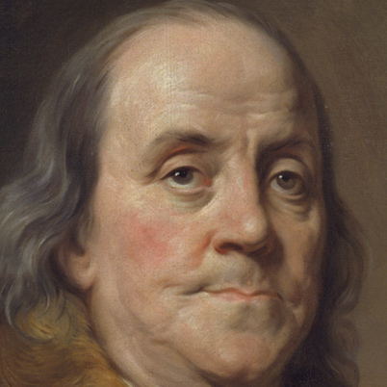
Now…SELLING
To WHOM?
  Family
  Employees
  “Big Guys”
Earnings buys OPTIONS!

Slide 143

Enslaving the children.

Slide 144

The story of the Family Farm…

Slide 145

Your BEST Team Members…
If they can’t GROW…they’ll GO!

Slide 146
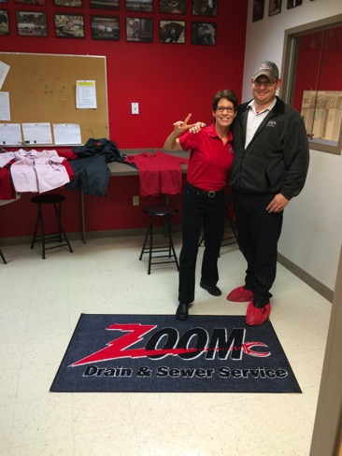
A Stake In the Outcome
ESOP Employee Stock Ownership Plan
  Maybe…if you are profitable and have cash.
  Or, you could owner finance a buyout.

Slide 147
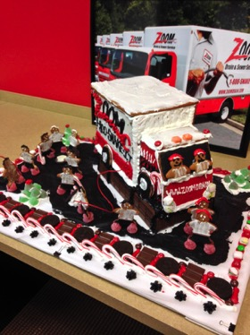
The Mothership Model
Mothership houses
  Admin/Finance
  Marketing
  One production company
Satellites…
  One production company
  One FIZZY Manager with a Stake in the OUTCOME!

Slide 148
A few parting thoughts…
Play out the scenarios in your BUDGET.
Don’t be intimidated!
Craft an asset-only deal.
You win some, lose some…
…some are easy and some are harder.
Your willingness to walk away…
LISTEN to your gut.
There’s more to it than this!
“Plan or be planned for.”

Slide 149
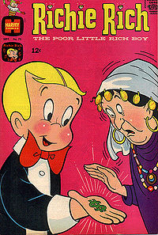
Someday your PRINCE may come…
…looking for EARNINGS.

Slide 150
The Bare Bones Biz Plan
Setting Sight
Building the Team
Making Money
Getting it Sold
Getting it Done
Making Sure
Notes:
How would you do it? Start with a plan. My latest book is The Bare Bones Biz Plan. In this book, I wrote down the few things that, if done on a consistent basis, would make all the difference to your business success. I am proud of this book. It is a sound, simple approach to putting a winning business plan together and for holding yourself accountable for getting it done.
Now, if you have a plan already, use it. Dust off the one you showed to the bank 100 years ago and start with that. If you don’t have a plan, try this:
Get a three ring binder. You can get a nice leather one at Office Depot for about 30 bucks. Or, use one of your kids’ sixth grade leftovers. Make sure it is in nice, clean condition. Your best work is going in it. This Binder is going to house your Business Plan. Call it your Biz Plan Binder.
Get at set of tabs that fit into your Biz Plan Binder. Get the customizable, write-on kind with 8 tabs in the set. Tab up your Binder like this…
Setting Sight – What does it look like when you're done? How much in Sales? How many employees? Number of customers served? What services will you offer? What will you do different and better from the competition? This tab of your Biz Plan Binder houses the pages that describe your ideal business, your target market, your goals and how this business serves you, your family, your team and your customers.
Building the Team – Who does what? Why, how and when? Use this section of your Biz Plan Binder to store your Organizational Chart and Position Descriptions. Keep your recruiting activities organized here.
Making Money – Keep a current copy of your financials in this section. Are your books a mess? Craft an action plan for getting to KFP – a KNOWN Financial Position. Build a Budget and set Goals, in $$s and %s for Sales and Expenses at your new and improved company. Get REAL about your selling price. Crunch the numbers…and commit to implementing higher prices. Which leads us to…
.
Getting it Sold – If you are going to charge more (and, face it, cutting costs won’t make up for years of financial losses) you are going to have to BE more…be faster, nicer, cleaner, more organized, professional, timely and loving. And, you will need to discover better ways to communicate the value of your service to customers and prospective customers. Craft an action plan for improving your sales skills. Store your marketing plan under this tab in your Biz Plan Binder.
Getting it Done – As you develop your procedures, sure-fire systems for delivering on your promises, store copies of your procedures under this tab. Create a Top Projects list and assign projects to Team members. Be sure to include the due dates. Note the employees who rise to the 7 day Extreme Makeover Challenge. These are folks you want on your team.
Making Sure – Are you on the right track? Are you delivering what people want? Is this working? Ride along with your field team. Sit side by side with your inside team. Ask your customers to give you feedback…what’s working, what needs to be madeover? Organize your Making Sure activities in this tab of your Biz Plan Binder.
(Sure, you could keep all this information on your computer. Do it! However, a nice, printed, portable Biz Plan Binder is helpful for showing others where you are going and how you are going to get there.
Also, feel free to “plus” my suggestions. These tabs are one way to organize your plan. Got another approach? Terrific. Use it!)
The two additional tabs can be used for the Master To Do List and your Journal.
The Master To Do List – You are going to have lots of great ideas for your business. However, you can’t do everything all at once. You will learn to prioritize your ideas and focus your energy on the things that will have the most impact on your business success. When you, or a team member, have a good idea, or think of something that needs to be done, a “to do”…jot it down on the Master To Do List.
The Journal – This is where you write down the story of your business. You can use a Word document, and type out your thoughts. Or, insert a few blank pages and store them in the Journal section of your Biz Plan Binder. Date your entries. You will learn wonderful lessons as you create and implement your business plan. Keeping a Journal will help you to remember those lessons, and give you a nice way to pass the lessons along.

Slide 151
The Meeting with YOU
Intention to Action…
  Your Biz Plan
  The Top Projects List
  The Master to do List
  Your Calendar
Notes:
Deep Dish
SHOW the Calendar…DEMO the Meeting with YOU!
MAKING GOOD ON YOUR PROMISES!

Slide 152
www.ellenrohr.com/cole

Slide 153
www.ellenrohr.com/cole

Slide 154
Thank You!
Notes:
Closing thought: Make the commitment. Plan your business and discover the freedom that an honorable, profitable, true-to-you business can bring. Click on the Chat link to get to the site.

